Slide 1
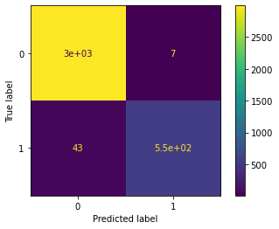
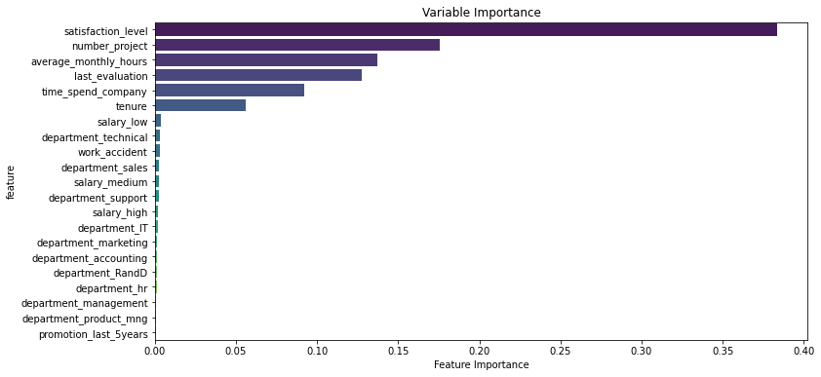
Salifort Motors Employee Retention
Executive Summary for HR department, Salifort Motors
Salifort Motors is grappling with a high rate of employee turnover, which is costly in terms of recruitment, training, and upskilling efforts. The company is seeking to understand the underlying causes of this turnover to develop effective retention strategies.
Our team conducted a comprehensive analysis of employee data, including surveys and historical records, to identify key factors contributing to employee departures. We developed and tested a Random Forest model, a powerful machine learning algorithm, to predict employee turnover based on various job-related attributes.
Confusion matrix showing model performance.
The model's results have revealed that job satisfaction, workload, and career progression opportunities are critical factors. Employees who work long hours and have low satisfaction levels are more likely to leave, even if they receive high performance evaluations.
Important features in predicting employee turnover.
Job Satisfaction: Employees with high satisfaction levels are less likely to leave, indicating that fostering a positive work environment is crucial.
Workload Management: While long working hours can be a concern, other factors such as job satisfaction and career progression seem to be more influential.
Career Progression: Only 1.01% of employees in the high-workload group had received a promotion in the last five years, suggesting a need for more opportunities for career advancement.
Performance Evaluations: High performance evaluations do not necessarily correlate with retention, indicating that other factors may be at play.
Model Performance: The Random Forest model achieved an impressive Area Under the Curve (AUC) of 96%, demonstrating its effectiveness in predicting employee turnover. The model's accuracy, precision, recall, and F1 score also reflect its strong performance.

